Slide 1
CS 542 PROJECT
Link state routing algorithm
SUBMITTED By :
first name : Sachin
last name : Krishna murthy
cwid : a20354077

Slide 2
Introduction
Routing :
Basically Routing is the process of selecting the best paths in a network. However, Routing is also described as forwarding. Routing is usually performed by a device called Router. In internetworking, the process of moving a packet of data from source to destination. Routing is a key feature of the Internet because it enables messages to pass from one computer to another and eventually reach the target machine. Each intermediary computer performs routing by passing along the message to the next computer.
Some of the applications of Routing are :
Telephone Network : Circuit Switching
Electronic Data Network : Internet
Transportation Networks

Slide 3
Link State Routing Protocols
Link State Routing Protocols are one of the two main classes of routing protocols used in packet switching networks for computer communications and the other being the distance vector routing protocols.
The basic concept of link-state routing is that every node constructs a map of the connectivity to the network, in the form of a graph, showing which nodes are connected to which other nodes.
Each node then independently calculates the next best logical path from it to every possible destination in the network. The collection of best paths will then form the node's routing table.

Slide 4
Characteristics :
Link State Routing Protocols have the following Characteristics :
Shortest Path First Algorithm
Cost Metric
Hello Packets
Link State Packets
Topology

Slide 5
Advantages and Disadvantages
Advantages :
Faster Convergence
Triggered Updates
Scalability
Disadvantages :
Greater Processing Requirements
Greater administrator knowledge

Slide 6
Dijkstra’s Algorithm
Djikstra's algorithm solves the problem of finding the shortest path from a point in a graph (the source) to a destination. It turns out that one can find the shortest paths from a given source to all points in a graph in the same time, hence this problem is sometimes called the single-source shortest paths problem.
For a given source node in the graph, the algorithm finds the shortest path between that node and every other. It can also be used for finding the shortest paths from a single node to a single destination node by stopping the algorithm once the shortest path to the destination node has been determined

Slide 7
Pseudocode
Initialization:
Visited = {source}
for all nodes v
if v is neighbor of source
then Distance(v) = cost(source,v)
else Distance(v) = ∞
Loop
find node w not in Visited such that Distance(w) is a minimum
add w to Visited
update Distance(v) for each neighbor v of w and not in Visited:
Distance(v) = min( Distance(v), Distance(w) + cost(w,v) )
/* new cost to v = either old cost to v
or known least path cost to w + cost (w,v )*/
until Visited = all nodes

Slide 8
Instructions to Compile and Run the Program
Make sure you keep the input file in the same directory as of the source file.
The program is compatible for .txt file format. So make sure that a .txt input file is chosen and it should contain numeric values in a square matrix with the values separated by a single space.
Since the class name mentioned in the program is ProjectMain, you can compile the program in the command prompt using the command :
javac ProjectMain.java
After compilation you can run the program using the command :
java ProjectMain
You can also run the program using jar from the folder where the input file is present as :
java –jar ProjectMain.jar
The application will start running and you can enter the choices as per your requirement.

Slide 9
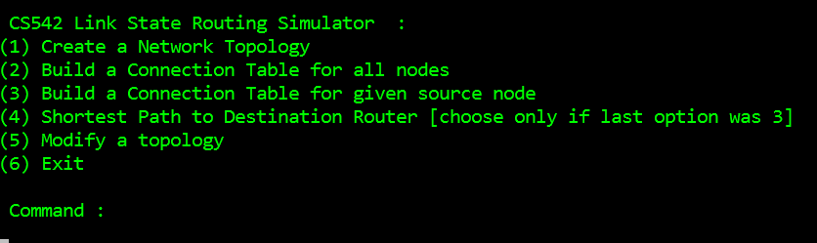
Implementation Steps
Initially the user is prompted to enter the name of the input file.
After entering the input filename, the options available for CS542 Link State Routing Simulator are displayed. Also the user is prompted to enter the option.

Slide 10
Continued …
For option 1 i,e Create a Network Topology, the input topology matrix will be displayed.
For option 2, Build a connection table for all nodes, the connection table of all the routers existing in the input file will be displayed.
For option 3, Build a connection table for a given source node, the user will prompted to enter the source node for which he wants to display the connection table.
For option 4, Shortest path to the destination router, the user will be prompted to enter the destination node to which he wants to determine the shortest path from the source node mentioned in the option 3.

Slide 11
Continued …
For option 5, Modify a topology, the user will be prompted to enter the node which he wants to remove from the input file.
After entering the node to be removed, that node will no longer exist in the input file.
For option 6, Exit, indicates the end of operation and displays the message “Good Bye”.

Slide 12
Constraints handled
Constraint 1: When a user enters a wrong input filename. For example, the input file name is “input.txt” but mistakenly the user enters it as “iinput.txt”, then a suitable error message “File not found” is displayed. Also the operation will be terminated displaying the exit message.
Constraint 2: If the input file contains some junk data such as non numeric data then a suitable error message “File contents invalid” and “File does not contain Topology matrix” is displayed. Also the operation is terminated with a exit message.
Constraint 3: If the input topology matrix is incorrect, then the mistake in the topology matrix is identified and displayed. Also the operation is terminated and exit message is displayed.

Slide 13
Continued …
Constraint 4 : We know that in an input matrix, the distance from 1->1 is 0, the distance from 2->2 is 0 and so on. But if the input matrix contains a non zero value for these cases, then a suitable error message is displayed and the operation is terminated.
Constraint 5: For example, consider that the input file contains 8 nodes. While executing option 3, Building connection table for given source node, and consider that the user enters source node as 9. Since we have only 8 nodes in our input file, node 9 does not exist. This constraint is handled by displaying a suitable error message “Node does not exist in the network” and also prompts the user to enter a new source node.
Also the same error message will be displayed when we use the option 4 to find the shortest path by entering the destination router that does not exist in the network.

Slide 14
Continued …
Constraint 6: It is necessary that the user needs to specify the source node first than the destination node inorder to find the shortest path between them. In case if the user tries to enter the destination node (option 4) before giving the source node (option 3) then the user is prompted to choose option 3 i,e the source node first and then choose option 4 for giving destination node.
Constraint 7: When the user chooses option 5 to modify a topology that is to remove a node from the matrix, and then if we chooses option 3 to build a connection table for the source node and if he enters the node which he has already removed then a suitable message is prompted like “Node does not exist in the network”.

Slide 15
Continued …
Constraint 8: By using the option 5, if the user tries to remove all the nodes in the matrix, say for example the input consists of 8 nodes. Then the user is allowed to remove upto 7 nodes. After removing 7 nodes there are no more operations possible. So a suitable message is displayed for this constraint and the operation is terminated.
Constraint 9: In this case, the link simulator displays 6 options as shown. If the user tries to enter a command more than 6, then the message “invalid option” is displayed.
Constraint 10 : If the user specifies the node to be removed using option 5 and enters the node which is not their in the input file, then a suitable message “Invalid Node” is displayed.

Slide 16
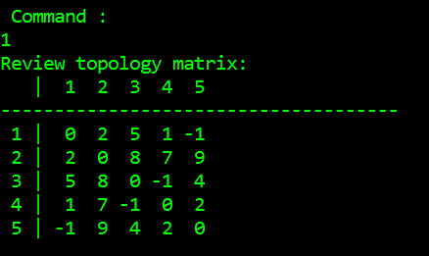
Test Results
Considering a 5*5 input matrix
Option 1: Create a Network Topology

Slide 17
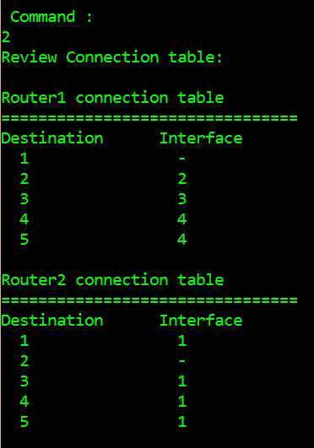
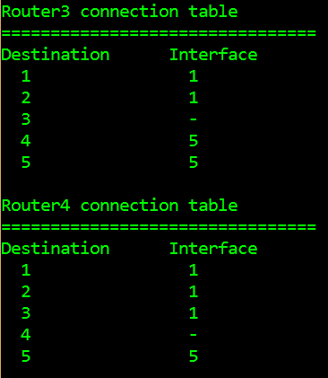
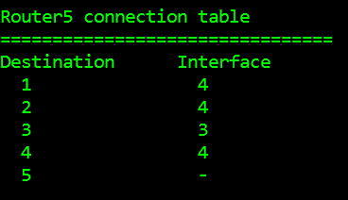
Continued …
Option 2: Build Connection Table for all the Routers

Slide 18
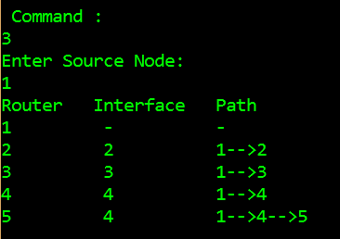
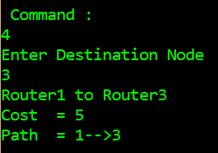
Continued …
Option 3 : Build a Connection Table for the source node
Option 4 : Finding the shortest path

Slide 19
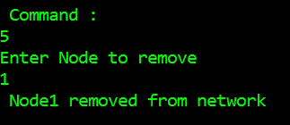
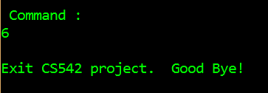
Continued …
Option 5 : Modify a topology
Option 6 : Exit

Slide 20
Thank You

